Slide 1
Optical power budget as it relates to link gain
Link Number *
Modulator Serial #
Detector Serial #
Measured Photocurrent
Measured Gain
Gain margin
relative to – 35 dB
relative to – 40 dB
Optical power margin
relative to – 35 dB Gain
relative to – 40 dB Gain
1
0228Q002
500372
1.21 mA
– 31.5 dB
3.5 dB
8.5 dB
1.8 dB
4.3 dB
2
0228Q005
500373
2.90 mA
– 26.0 dB
9.0 dB
14.0 dB
4.5 dB
7.0 dB
3
0228Q014
500378
1.14 mA
– 32.6 dB
2.4 dB
7.4 dB
1.2 dB
3.7 dB
4
0228Q003
500379
2.78 mA
– 25.9 dB
9.1 dB
14.1 dB
4.6 dB
7.1 dB
* Numbering for the purposes of this list only

Slide 2
Optical power budget as it relates to link dynamic range
Link Number *
Modulator Serial #
Detector Serial #
Measured Photocurrent
Spur-Free Dynamic Range **
SFDR margin
relative to 100 dB·Hz^{2/3}
relative to 95 dB·Hz^{2/3}
Optical power margin
relative to 100 dB·Hz^{2/3}
relative to 95 dB·Hz^{2/3}
1
0228Q002
500372
1.21 mA
101.2 dB·Hz^{2/3}
1.2 dB
6.2 dB
9.7 dB
20.9 dB
2
0228Q005
500373
2.90 mA
103.0 dB·Hz^{2/3}
3.0 dB
8.0 dB
18.3 dB
27.4 dB
3
0228Q014
500378
1.14 mA
104.2 dB·Hz^{2/3}
4.2 dB
9.2 dB
17.2 dB
25.5 dB
4
0228Q003
500379
2.78 mA
103.7 dB·Hz^{2/3}
3.7 dB
8.7 dB
19.9 dB
28.5 dB
* Numbering for the purposes of this list only
** SFDR was calculated from measured signal-to-distortion
ratio at one input power, assuming laser RIN = –150 dB/Hz

Slide 3
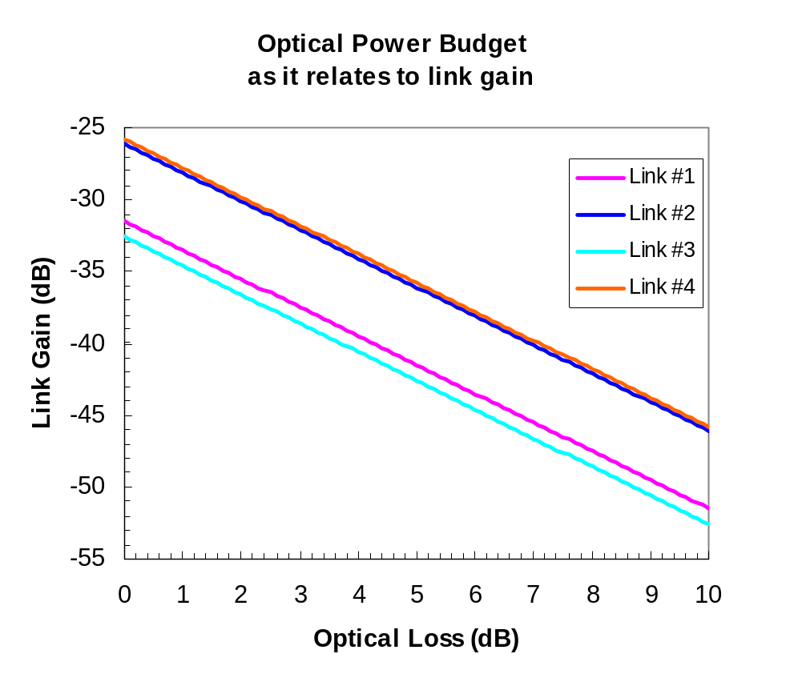
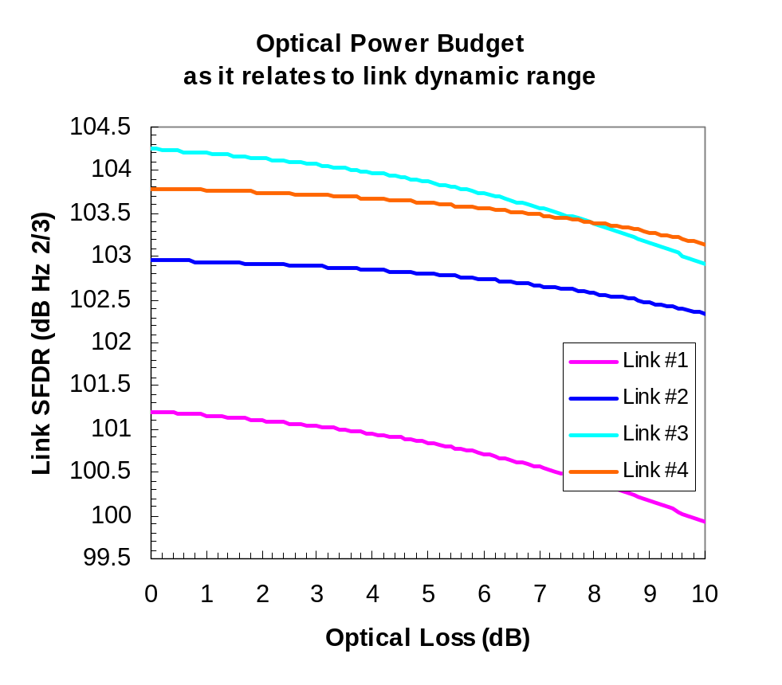
Optical power budget as it relates to link gain and dynamic range

